Slide 1
Porto Seguro’s
Safe Driver Prediction
Zexi Yuan, Jianqiao Liu, Wenlin Ou
Notes:
Hi everyone, this is group 9. My name is wenlin Ou, and this is zexi yuan and jianqiao liu.

Slide 2
Introduction
Problem background
Dataset Description
Approaches
Algorithms implemented
Evaluation Criteria
Experiment Results
Data Preprocessing
Tuning Parameters
Conclusions
Q & A

Slide 3
Part I: Problem Background
Porto Seguro is one of Brazil’s largest auto and homeowner insurance companies, hence setting reasonable insurance prices is beneficial for both the company and customers. We are given a dataset that contains drivers’ driving history and whether they have filed a claim in the past year. Our goal is to predict the probability that a driver will file a claim during the next year.
Notes:
Img url: https://scontent-atl3-1.xx.fbcdn.net/v/t31.0-8/22048009_10155798238193464_5349169435161795951_o.png?oh=65c91aff73219eb196fae16e9121e9e9&oe=5A8D09B9

Slide 4
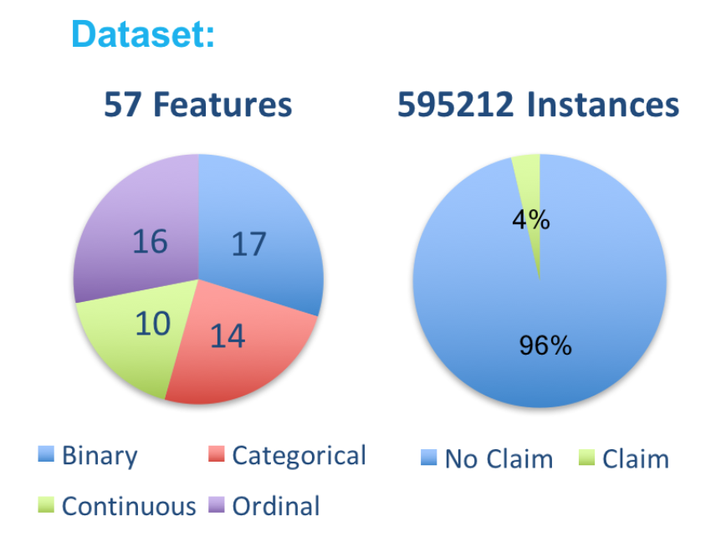
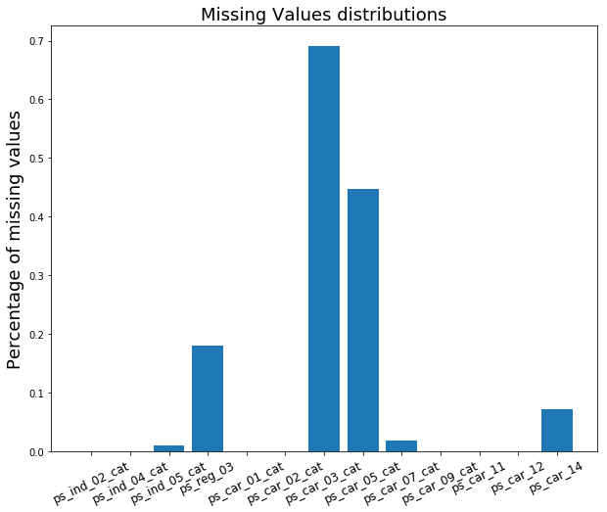
Dataset

Slide 5
Part II: Approaches
Logistic Regression
Random Forest
XGB
Notes:
Our algorithms are …
Now lets first look at how we evaluate our models.

Slide 6
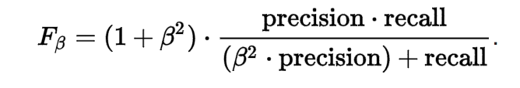
Model Evaluation: AUC & F-Score
AUC: area under ROC curve
ROC: TPR-FPR curve
F-score
Recall (TPR) = TP/(TP+FN)
Precision = TP/(TP+FP)
FPR = FP/(FP+TN)
Notes:
The question is, which criterion should we focus on?

Slide 7
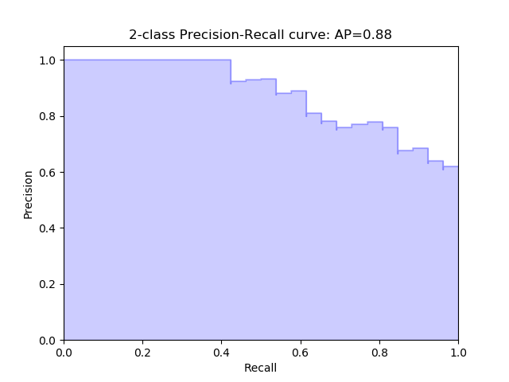
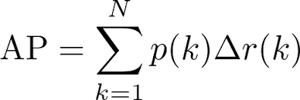
Average Precision Score
The precision-recall curve shows the tradeoff between precision and recall for different threshold.
AP score is the area under the Precision-Recall Curve
Notes:
So maximizing ap score

Slide 8
Part III: Results
Data Preprocessing
Experiment on Algorithms

Slide 9
Data Preprocessing
Feature Selection
One hot encoding
Missing Values

Slide 10
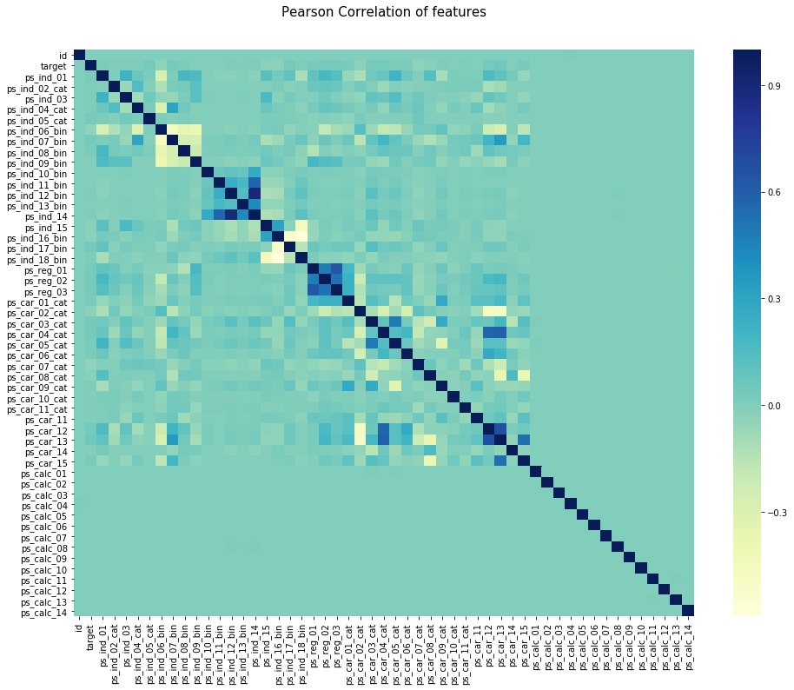
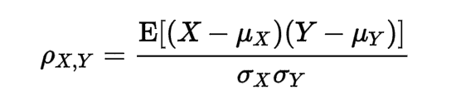
Pearson Correlation
Notes:
As shown on the heatmap, ps_calc_01 through ps_calc_14 has zero correlation with all other features, so we can safely drop these features as they are unlikely to have much impact on the result.
Check how to calculate pearson correlation

Slide 11
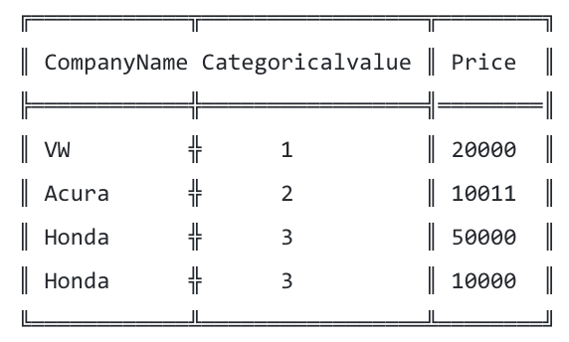
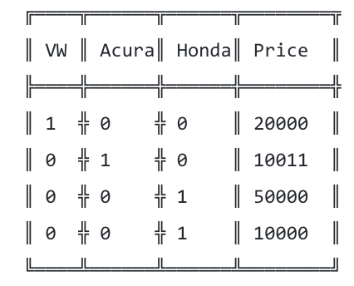
What is “One Hot Encoding”?

Slide 12
Logistic Regression
Package: sklearn.linear_model.LogisticRegression
Missing Value
Fill the missing values with mean for continuous data
Data Standardization (0 mean and 1 std)
Parameter: Inverse of regularization strength C = 0.1

Slide 13
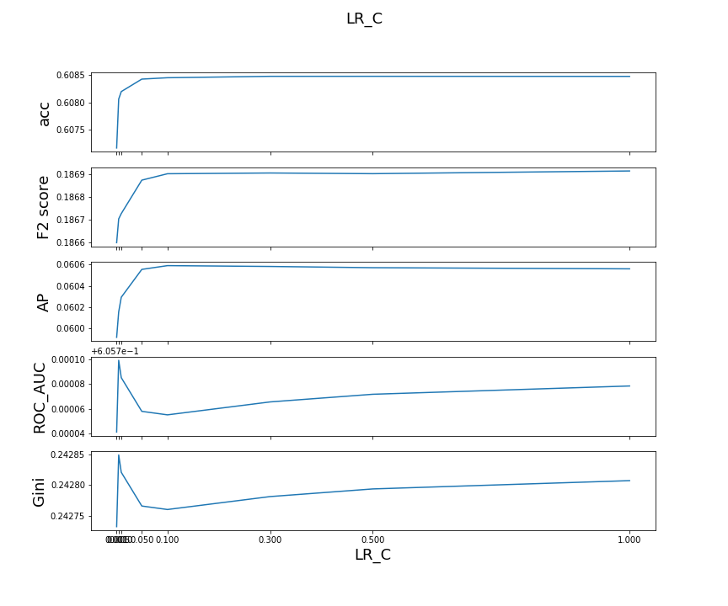

Slide 14
Random Forest
Package: sklearn.ensemble.RandomForestClassifier
Optimal Parameter
Number of trees: 120
Tree depth: 9
Leaf number: 7

Slide 15
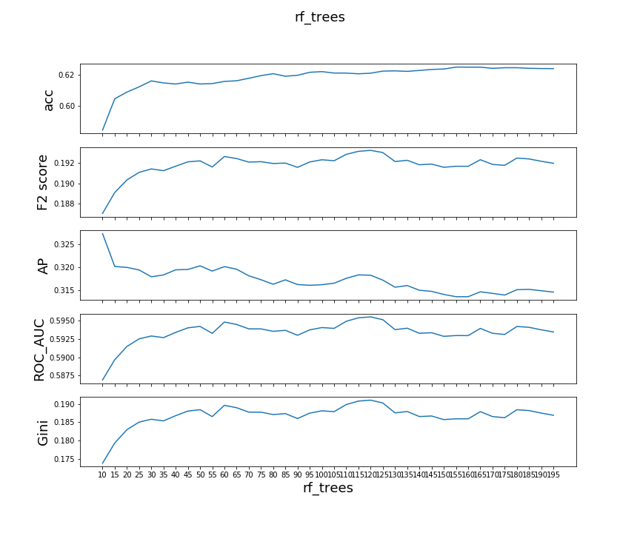
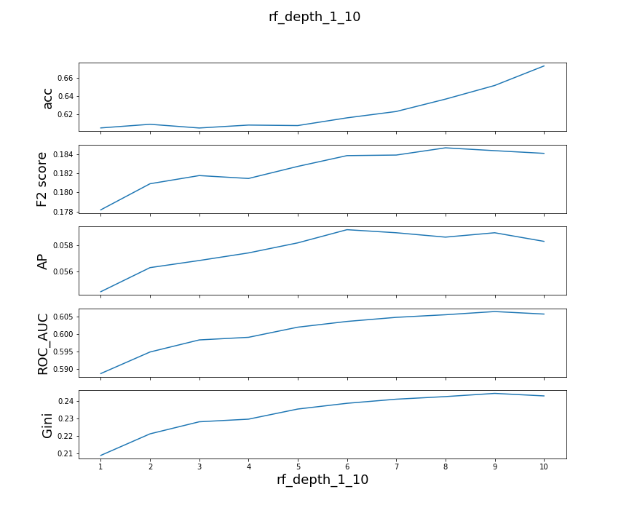
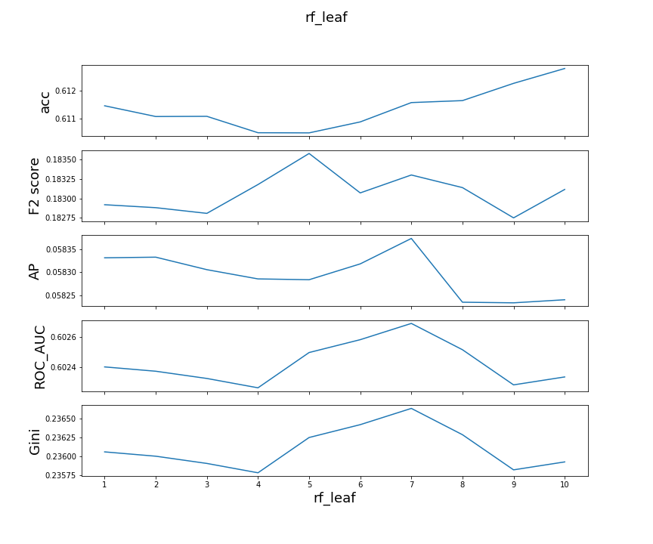

Slide 16
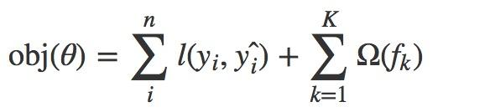
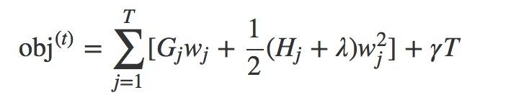
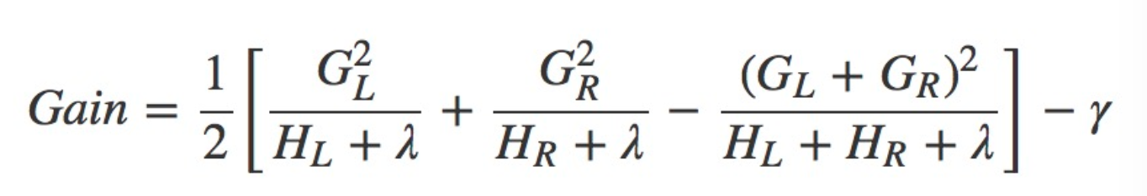
XGBoosting

Slide 17
XGBoosting
Package from https://github.com/dmlc/xgboost/
Optimal Parameters
number of estimators: 90
tree depth: 5
learning rate: 0.1
Gamma: 2

Slide 18
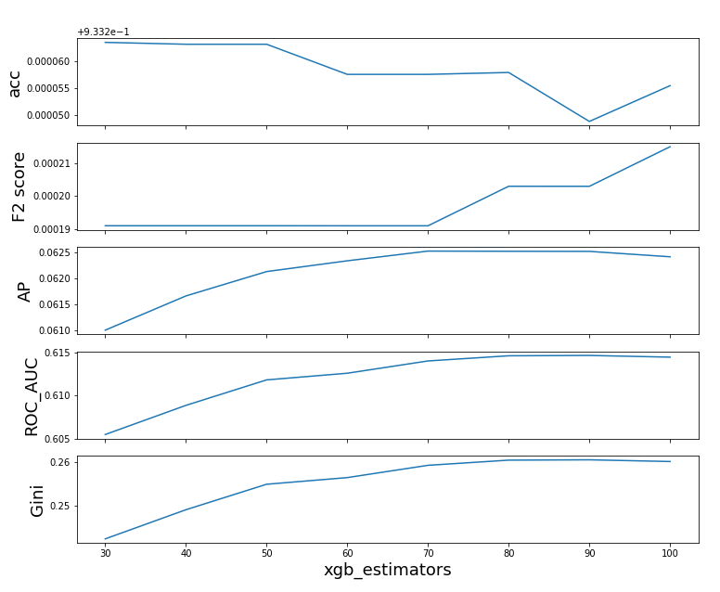
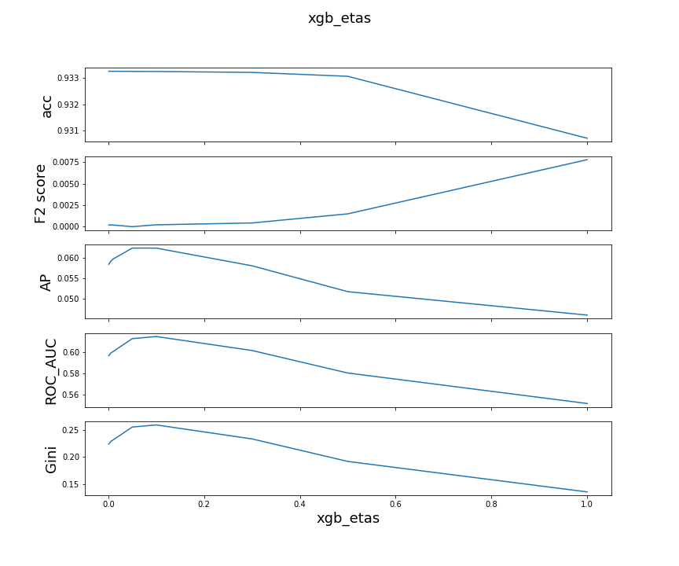

Slide 19
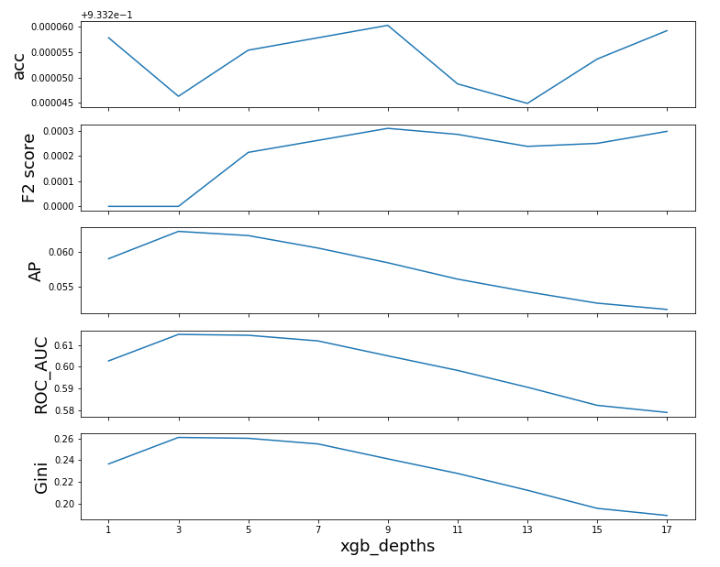
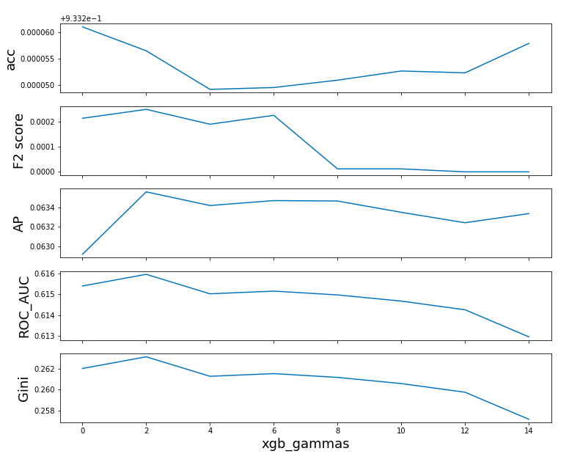

Slide 20
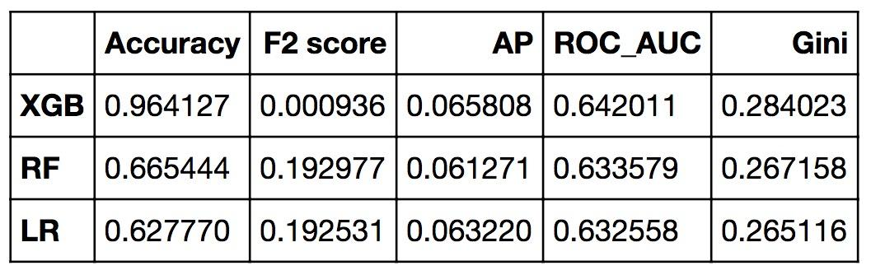
Comparison

Slide 21
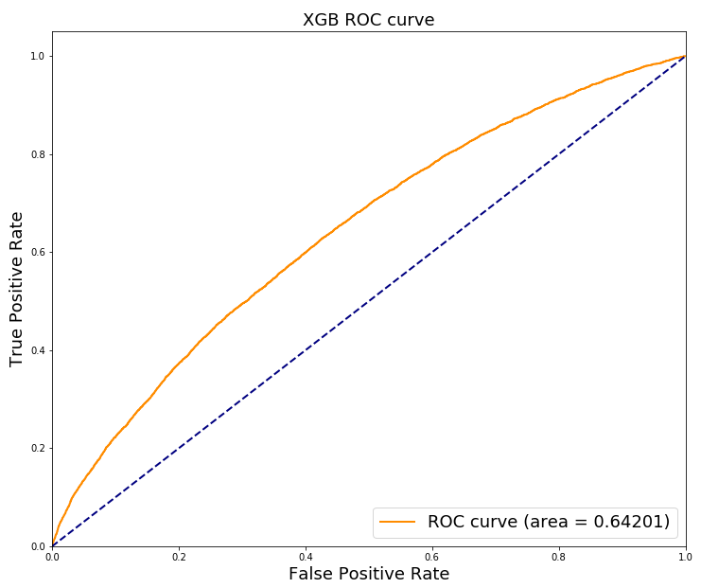
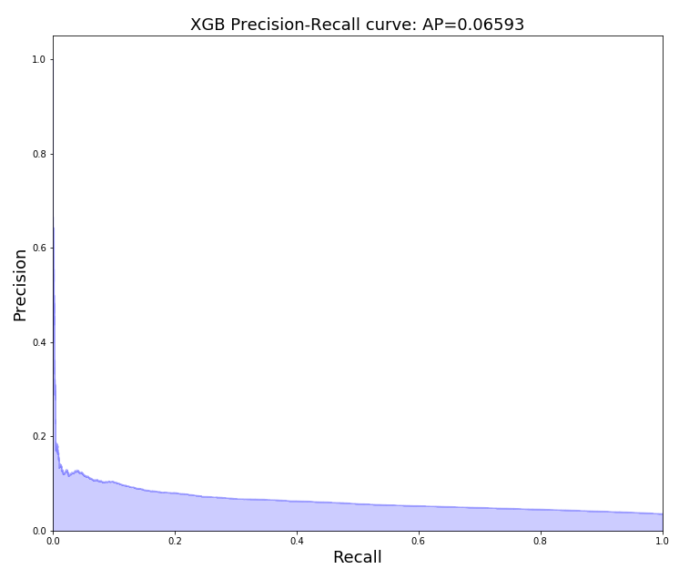

Slide 22
Part IV: Conclusions
Something to share:
AP Score as an extra evaluation criterion
Challenges we encountered:
Feature selection
No time for grid search

Slide 23
Q & A:
Thank You!

